Slide 1
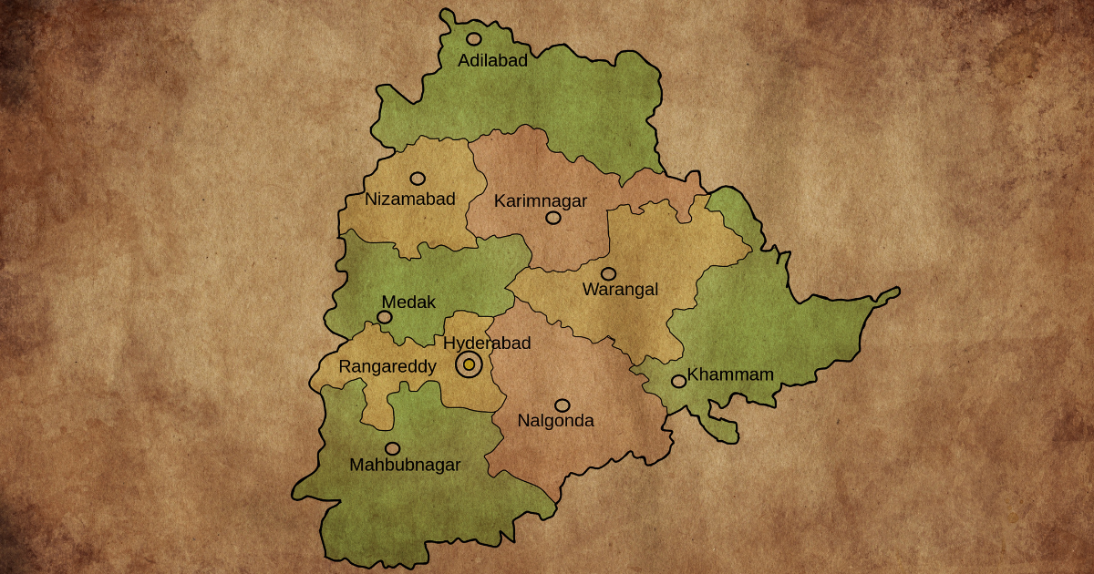
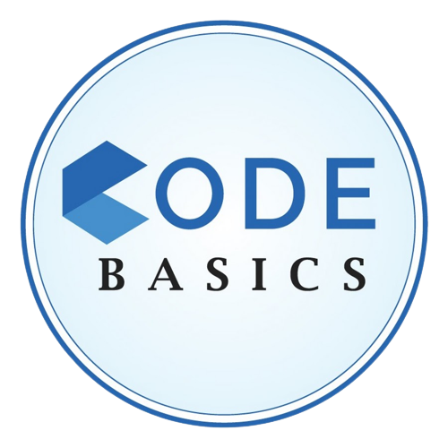
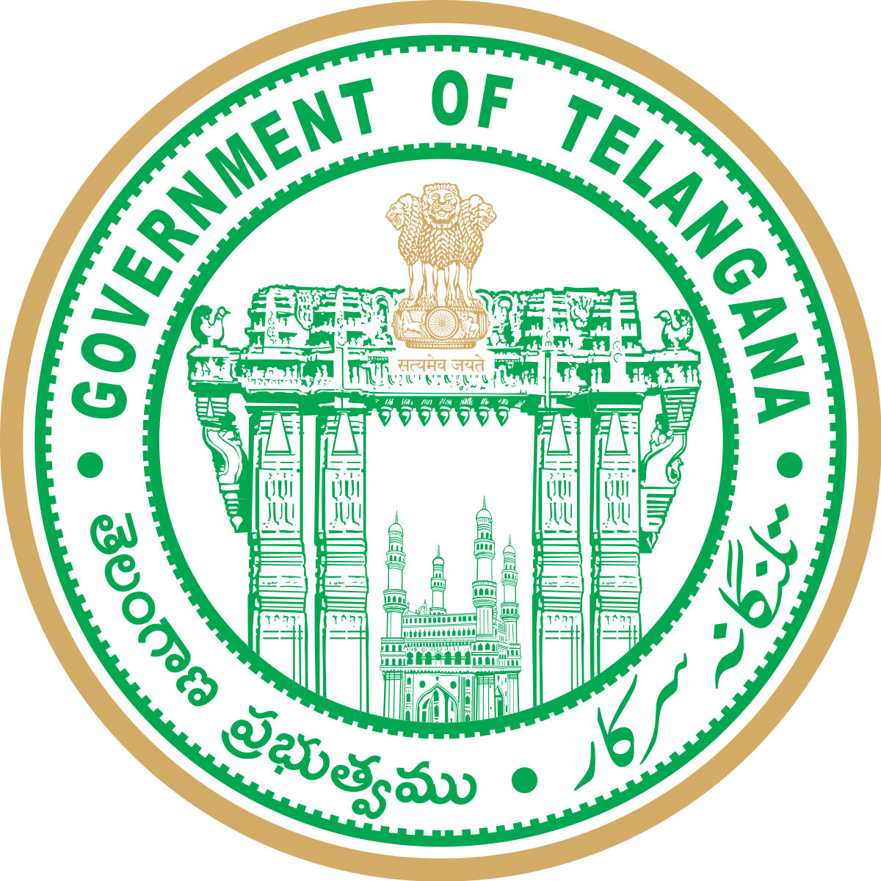
Telangana Growth Analysis
Hemanth

Slide 2
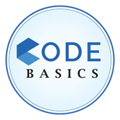

Contents
Introduction
Goals and Objectives
Preliminary Research
Secondary Research
Insights and Recommendation

Slide 3


Introduction
India's Telangana state was created in 2014. It is surrounded by the states of Maharashtra, Chhattisgarh, Andhra Pradesh, Karnataka, and Odisha and is situated in the south-central region of the nation. Hyderabad, the state's biggest city, serves as Telangana's capital.
Telangana's economy, which will have a gross state domestic product (GSDP) of 13.25 trillion (US$170 billion) in 2022, would be the seventh-largest in India. Numerous international firms and start-ups are based in the state, which serves as a key IT hub. Additionally, Telangana is a significant producer of wheat, cotton, and rice.
Telangana, a state in India that is expanding quickly and has an open data policy, has made all of its data available online. Investigating Telangana's substantial growth across many areas can provide insightful information for the government. These observations can help data-driven choices to increase the state's progress.

Slide 4







Objective
Explore Stamp Registration, Transportation and Ts-Ipass Datasets.
Understand their attributes, categories and time period.
Analyze trends and patterns within each department.
Find correlation among these departments and report the overall growth of the state through insights and relevant visuals such as shape maps
Identify growth opportunities and areas needing attention.

Slide 5

Preliminary Insights

Slide 6

Stamp Registration Analysis

Slide 7


Stamp Registration Analysis
In this part, we will focus on analyzing important data about document registration and e-stamps in Telangana.
This data provides information about the revenue generated from document registration, the number of e-stamp challans issued, and other related data.

Slide 8
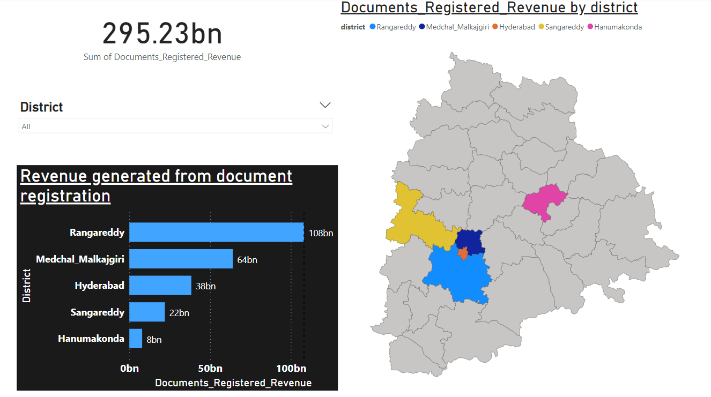
1. How does the revenue generated from document registration vary across districts in Telangana?

Slide 9
Insights
The total revenue generated from document registration in Telangana is 295.23 billion rupees. Rangareddy district accounts for 36.6% of this revenue, followed by Medchal Malkajgiri (21.8%), Hyderabad (13.0%), Sangareddy (7.5%), and Hanumakonda (14.1%).
The revenue generated from document registration is a significant contributor to the economy of Telangana. It is used to fund a variety of government programs and services.
The high revenue generated from document registration is Rangareddy district which is likely due to its large population and its status as a major commercial and industrial hub.
Medchal Malkajgiri district is also a major commercial and industrial hub, and it is home to the Rajiv Gandhi International Airport. Hyderabad is the capital of Telangana and is home to a number of government offices and educational institutions. Sangareddy district is home to a number of manufacturing industries. Hanumakonda district is a major agricultural district.
The revenue generated from document registration is likely to continue to grow in Telangana in the coming years. This is due to the state's growing population and economy.

Slide 10
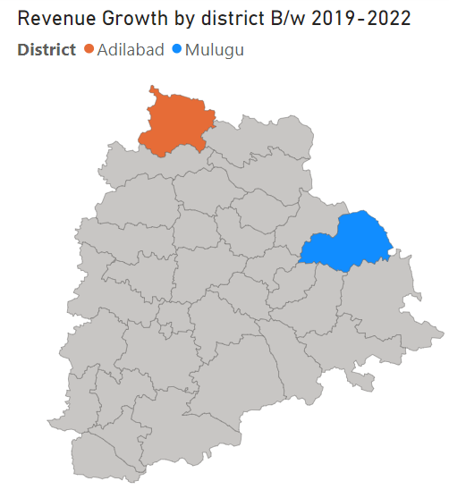
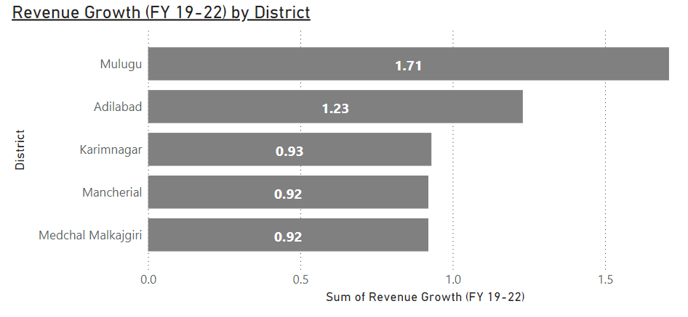
1. The top 5 districts that showed the highest document registration revenue growth between FY 2019 and
2022.
The visualization shows that the district of Mulugu had the highest revenue growth, with a growth of 171%. The district of Adilabad was second, with a growth of 123%. The other districts in the top 5 are Karimnagar, Mancherial and Medchal Malkajgiri. The total revenue growth for the top 5 districts is 150%. This means that the document registration revenue in these districts has doubled in the last 3 years.

Slide 11
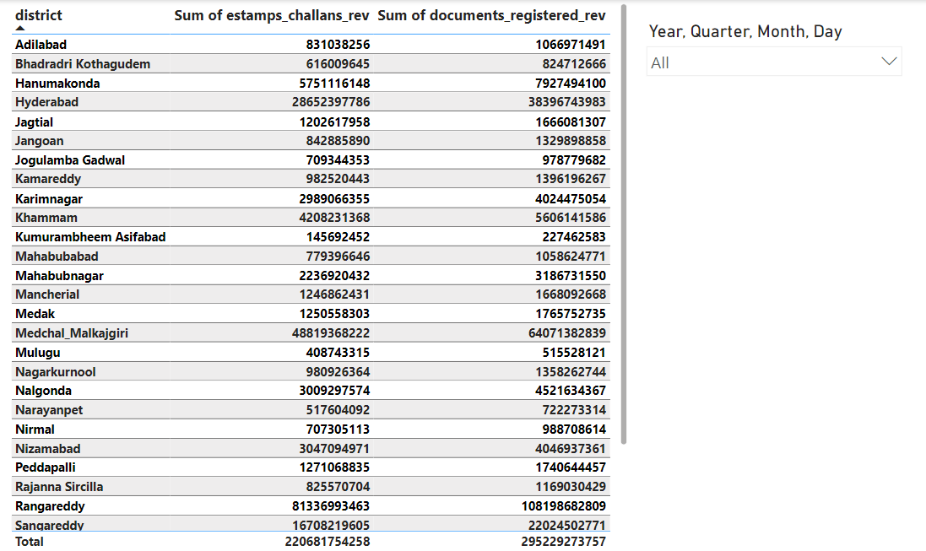
2. How does the revenue generated from document registration compare to the revenue generated from e-stamp challans across districts?

Slide 12
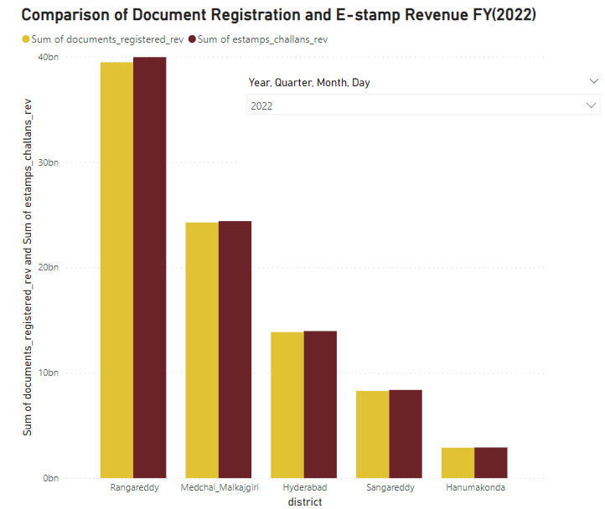
2. The top 5 districts where e-stamps revenue contributes significantly more to the revenue than the documents in FY 2022
The e-stamp revenue is highest in the district of Rangareddy, followed by Medchal Malkajgiri and Hyderabad. This suggests that these districts are more digitally advanced and have a higher proportion of businesses and individuals who are comfortable using e-stamps.
Rangareddy: The district generates the most money, around 37 billion from registration of documents and 38 billion from electronic stamp challans, showing a roughly equal involvement of both sources.

Slide 13
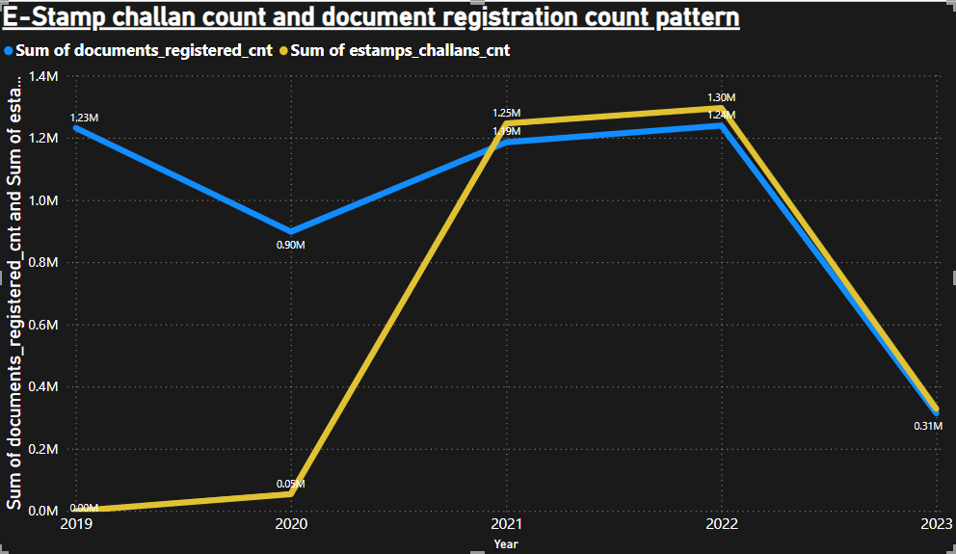
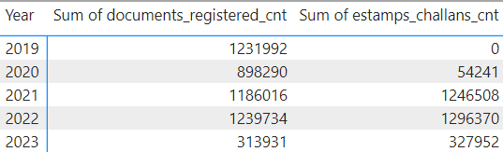
3. E-Stamp challan count and document registration count pattern since the implementation of e-Stamp challan
The number of e-stamp challans issued increased significantly in 2020, after the implementation of e-stamp challan. The number of documents registered also increased in 2020, but not as significantly as the number of e-stamp challans issued.
This suggests that the implementation of e-stamp challan made it easier and more convenient for people to pay stamp duty. As a result, more people started using e-stamp challans, and the number of documents registered also increased.

Slide 14

Suggestion to Government
The government to continue promoting the use of e-stamp challans. They can do this by making it easier for people to purchase and use e-stamp challans, and by educating people about the benefits of using e-stamp challans.
Here are some specific suggestions:
The government could set up a dedicated website or call center to answer questions about e-stamp challans.
The government could provide subsidies for businesses and individuals who use e-stamp challans.
The government could make e-stamp challans available at more locations, such as post offices and banks.
The government could educate people about the benefits of using e-stamp challans through public awareness campaigns.
By taking these steps, the government can encourage more people to use e-stamp challans, which will help to improve efficiency and transparency in the government revenue collection process.

Slide 15
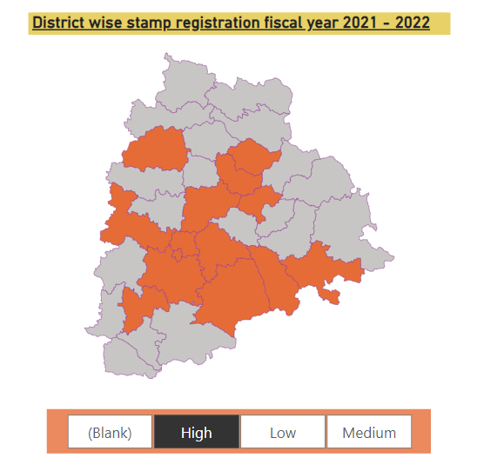
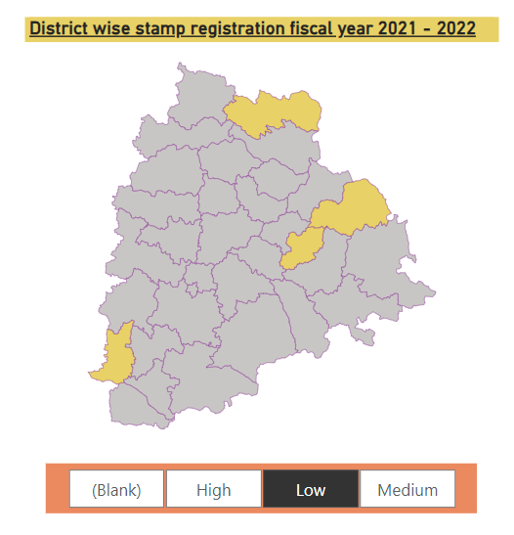
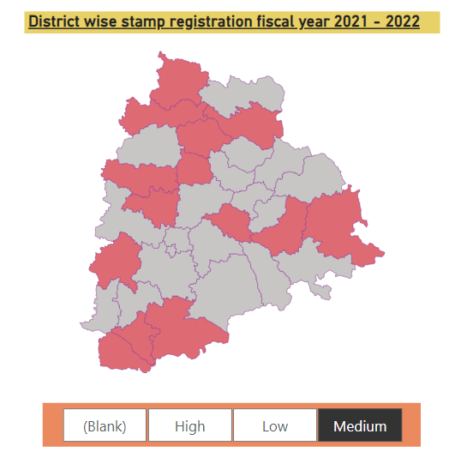
4. Categorize districts into three segments based on their stamp registration revenue generation during the fiscal year
2021 - 2022

Slide 16
Insights
The District Map in the previous slide shows the revenue from stamp registration in different districts of Telangana during the fiscal year 2021-2022.
District is divided into three segments: high, medium, and low. The districts in the high segment generated the most revenue from stamp registration, followed by the districts in the medium segment, and then the districts in the low segment.
The district of Rangareddy generated the most revenue from stamp registration, followed by the districts of Medchal Malkajgiri and Hyderabad.
The districts of Kumurambheem Asifabad and Mulugu generated the least revenue from stamp registration. There is a clear distinction between the districts in the high segment and the districts in the low segment. The districts in the high segment generated significantly more revenue from stamp registration than the districts in the low segment.

Slide 17
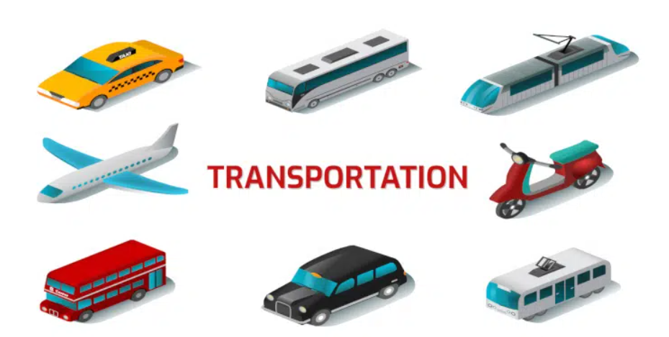

Slide 18
Transportation Analysis
In this section of our presentation, we will be exploring the analysis of vehicle sales data from the Road Transport Authority (RTA) of Telangana, with a specific focus on transport sales.
This dataset provides a comprehensive overview of individual vehicle sales within the state, offering valuable insights into the dynamics of the transportation sector.

Slide 19
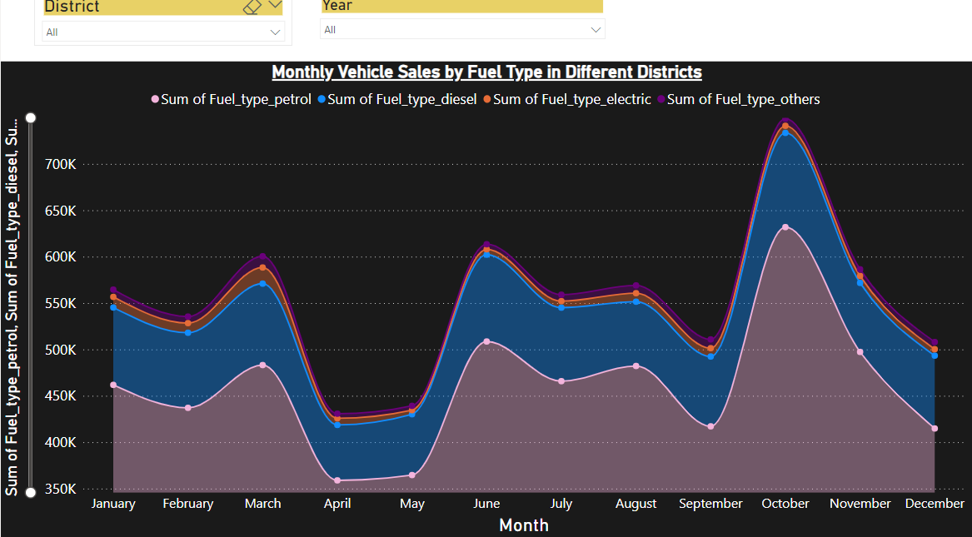
5. Investigate whether there is any correlation between vehicle sales and specific months or seasons in
different districts.

Slide 20
Insights
There is a correlation between vehicle sales and specific months or seasons in different districts. However, there are a few months or seasons that consistently show higher or lower sales rates.
April to May: These months tend to have the lower sales rates, which could be due to the Budget constraints. The start of the financial year in India is in April. This can lead to budget constraints for businesses and individuals, as they may be focused on other financial obligations.
October to December: These months tend to have higher sales rates, which could be due to the festive season.
The driving factors for these seasonal variations in vehicle sales could be:
Weather: Good weather is often associated with increased outdoor activities, which can lead to an increase in demand for vehicles.
School holidays: School holidays can also lead to an increase in demand for vehicles, as families may need to travel more.
Festive season: The festive season is often a time when people buy new vehicles, either as gifts or for themselves.

Slide 21
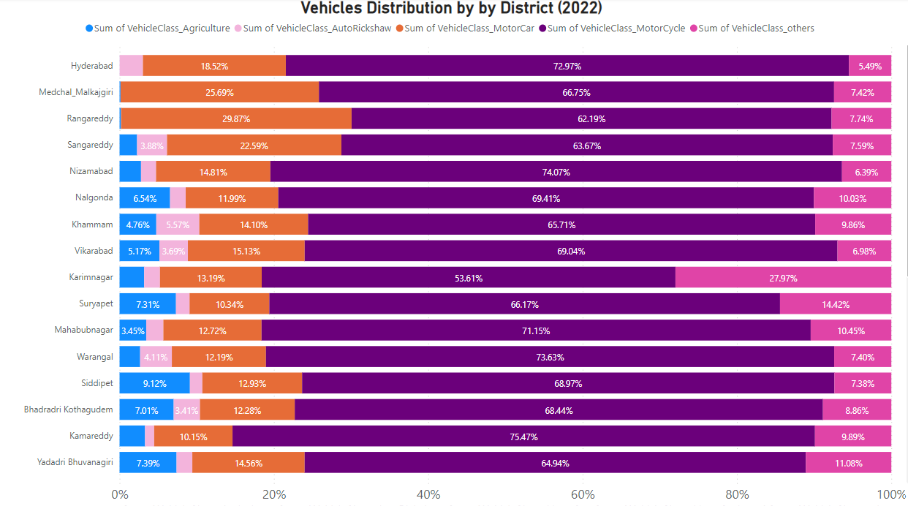
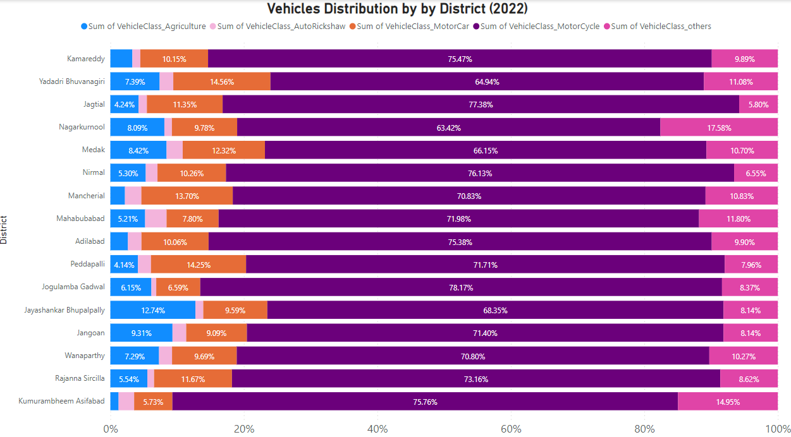
6. How does the distribution of vehicles vary by vehicle class (MotorCycle, MotorCar, AutoRickshaw, Agriculture) across different districts? Are there any districts with a predominant preference for a specific vehicle class? Consider FY 2022 for analysis.

Slide 22


Insights
Factors that Influence Vehicle Distribution
Population density: More densely populated districts tend to have more vehicles, especially Motorcycles and Autorickshaw’s. eg: Hyderabad, Ranga Reddy and Medchal-Malkajgiri
Economic development: More developed districts tend to have more vehicles, especially Motorcars. Eg: Rangareddy.
Infrastructure: Districts with better roads and other infrastructure tend to have more vehicles. Eg: Hyderabad
Rural/urban divide: Rural districts tend to have more Agriculture vehicles, while urban districts tend to have more MotorCycles, MotorCars, and AutoRickshaws.
Motorcycle Dominance
Motorcycles are the most common type of vehicle in all districts, indicating a common preference for two-wheelers in the region.

Slide 23
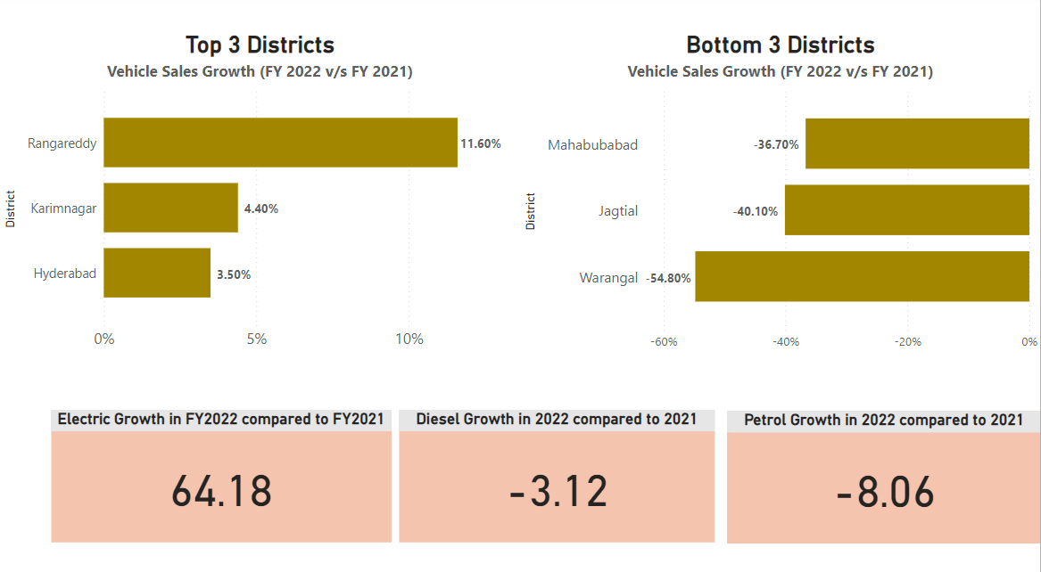
7. List down the top 3 and bottom 3 districts that have shown the highest and lowest vehicle sales growth during FY 2022 compared to FY 2021? (Consider and compare categories: Petrol, Diesel and Electric)

Slide 24


Observations
2.
The bottom 3 districts with the lowest vehicle sales growth are all located in the southern and eastern parts of Telangana. These districts are more rural and have lower population densities.
1.
3.
The top 3 districts with the highest vehicle sales growth are all located in the central and northern parts of Telangana. These districts are home to major cities and industrial towns, which could explain the higher demand for vehicles.
Electric vehicle sales growth is significantly higher than petrol and diesel vehicle sales growth in most districts. This suggests that there is a growing demand for electric vehicles in Telangana.

Slide 25

Ts-Ipass
Telangana State Industrial Project Approval and Self Certification System

Slide 26
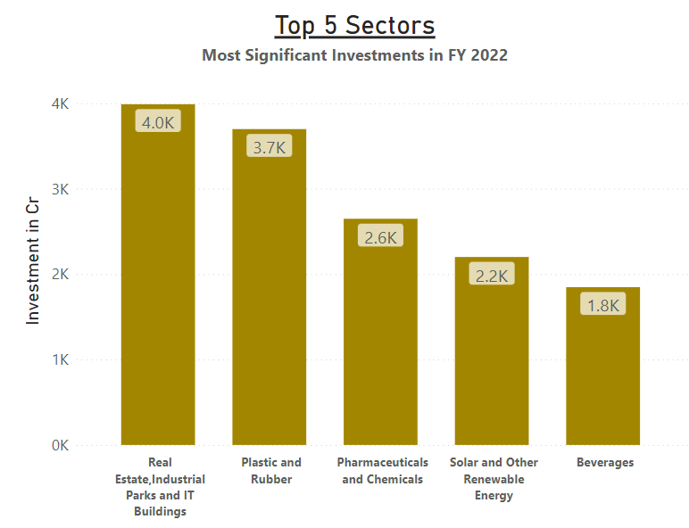

8. List down the top 5 sectors that have witnessed the most significant investments in FY 2022
Insight
Real estate, industrial parks, and IT buildings received the highest investment, followed by plastic and rubber, pharmaceuticals and chemicals, solar and other renewable energy, and beverages.
This investment is a testament to Telangana's strong economic growth and its attractiveness as an investment destination.

Slide 27
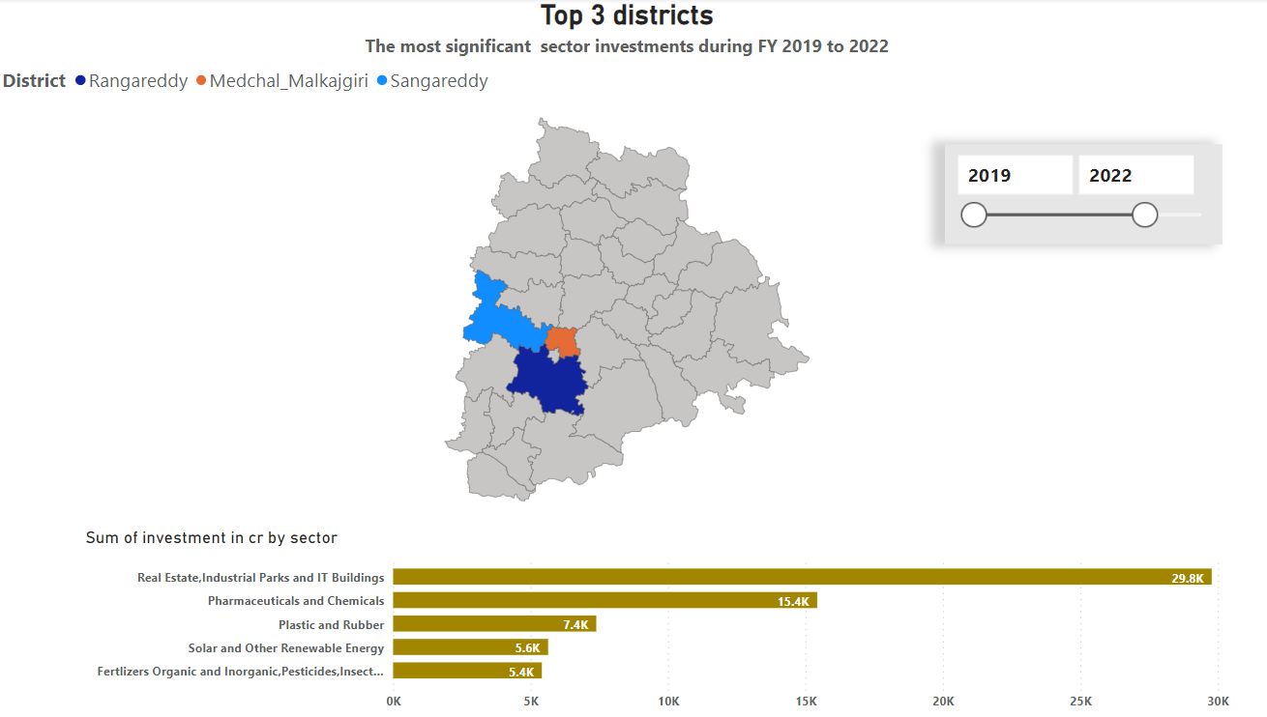
9. List down the top 3 districts that have attracted the most significant sector investments during FY 2019 to 2022? What factors could have led to the substantial investments in these particular districts?

Slide 28
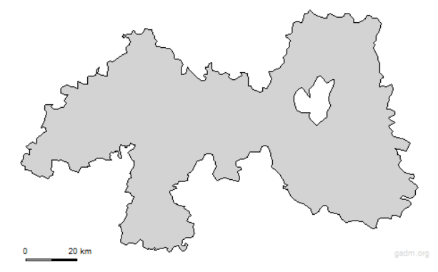
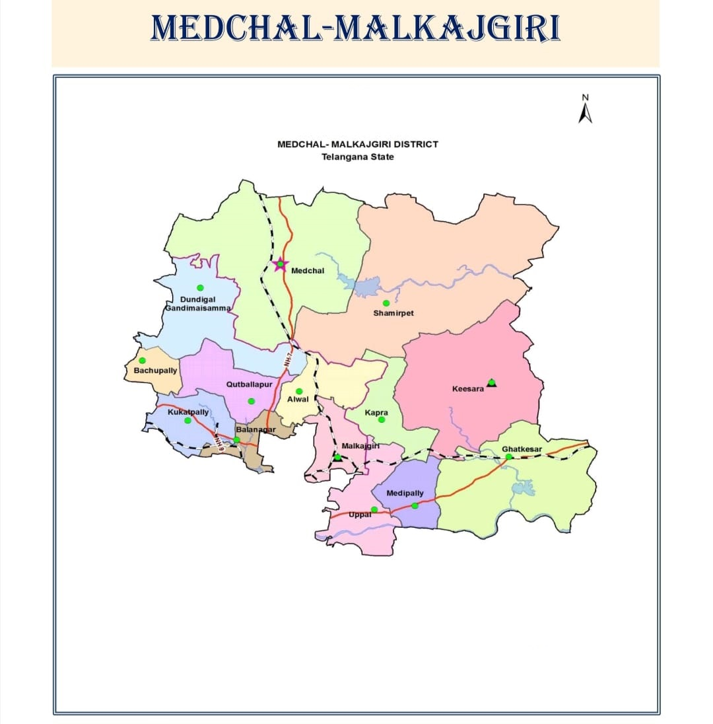
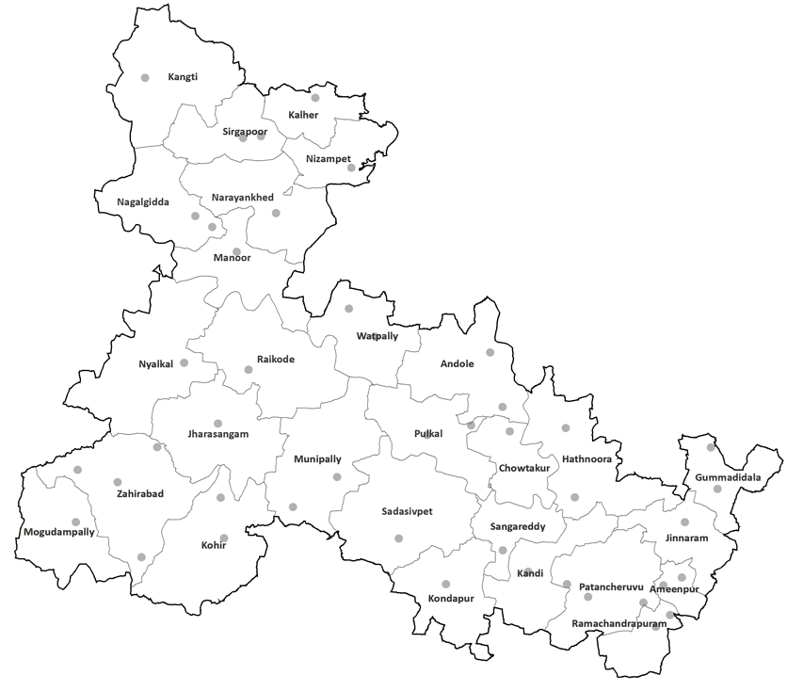
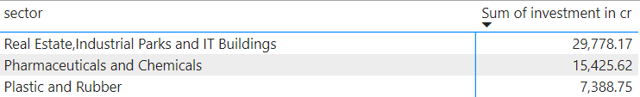
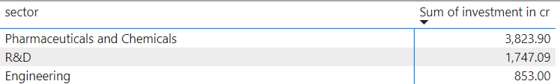
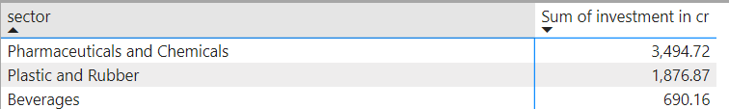
Rangareddy
Medchal Malkajgiri
Sangareddy
50000 cr
9000 cr
10000 cr
Total Sector investments during FY 2019 to 2022
Total Sector investments during FY 2019 to 2022
Total Sector investments during FY 2019 to 2022

Slide 29
The previous slide shows the most significant sector investments in Telangana districts during FY 2019 to 2022. The top three districts are Rangareddy, Medchal Malkajgiri, and Sangareddy. The following factors led to substantial investments in these particular districts:
The three districts are located in the heart of Telangana, with good connectivity to other parts of the state and the country.
1.Location
2. Infrastructure
The districts have well-developed infrastructure, including roads, railways, and airports.
3. Government support
The Telangana government has been proactive in attracting investments to the state. It has offered a number of incentives to investors, such as tax breaks and land subsidies.
The districts have a large pool of skilled workers, thanks to the presence of several educational institutions and training centers.
4. Skilled workforce

Slide 30
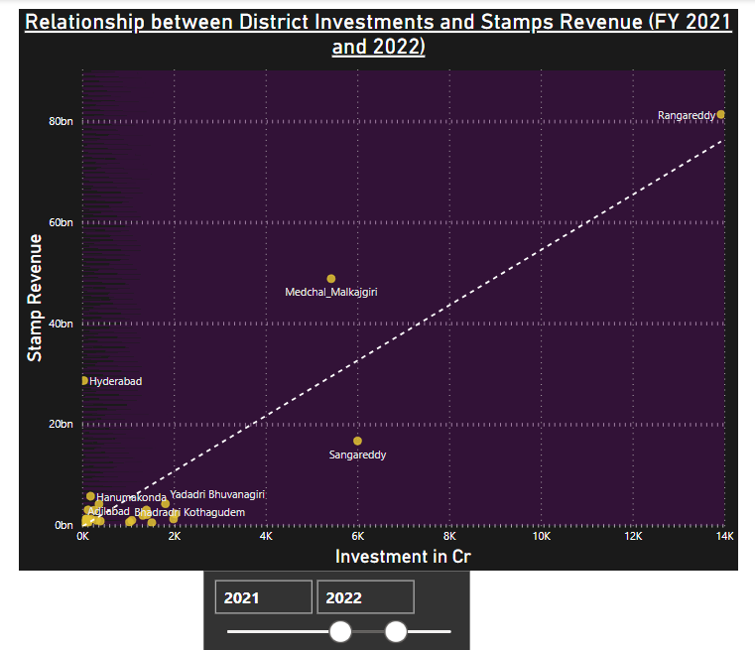

10. Is there any relationship between district investments and stamps revenue within the same district between FY 2021 and 2022?
Insight
There is a positive correlation between district investments and stamp revenue, meaning that as district investments increase, stamp revenue also tends to increase. This is likely because increased district investments lead to economic growth and development, which in turn leads to increased demand for real estate. As a result, people are more likely to buy and sell property, which generates stamp revenue for the government.

Slide 31
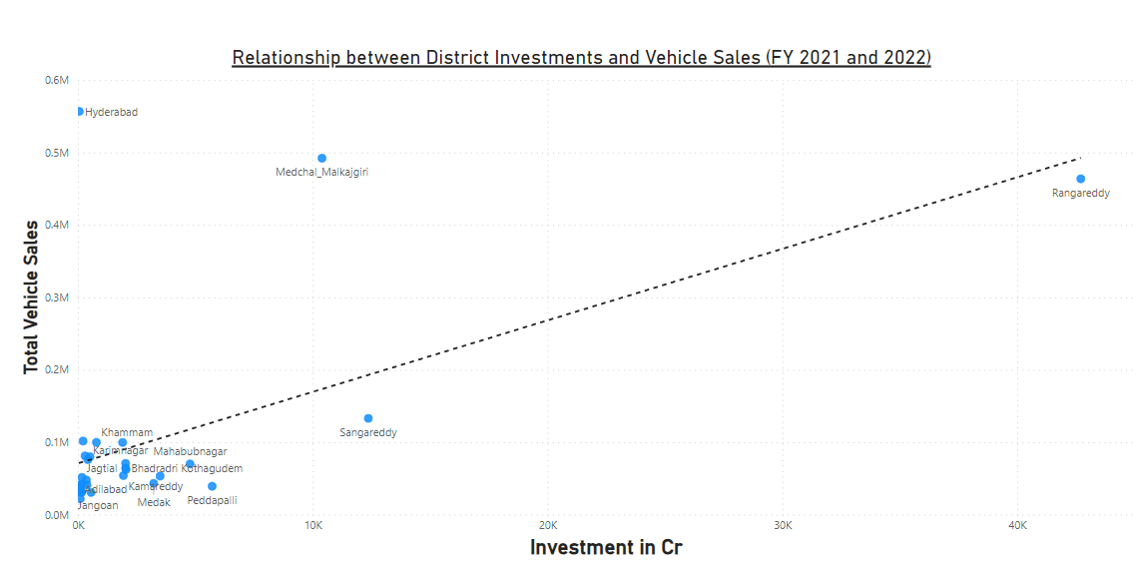
10. Is there any relationship between district investments and vehicles sales within the same district between FY 2021 and 2022?
While district investments may be correlated with vehicle sales, the relationship is not necessarily linear. Other factors, such as consumer preferences, infrastructure development, and economic conditions, can also influence vehicle sales.
For example, Hyderabad has lower district investments than some other districts in Telangana, but it may have higher vehicle sales due to its larger population, urbanization, higher income levels, and more developed transportation infrastructure. These factors can contribute to increased vehicle demand and sales.
In other words, vehicle sales are not simply determined by the amount of investment in a district. Other factors, such as the characteristics of the district's population and infrastructure, can also play a role

Slide 32
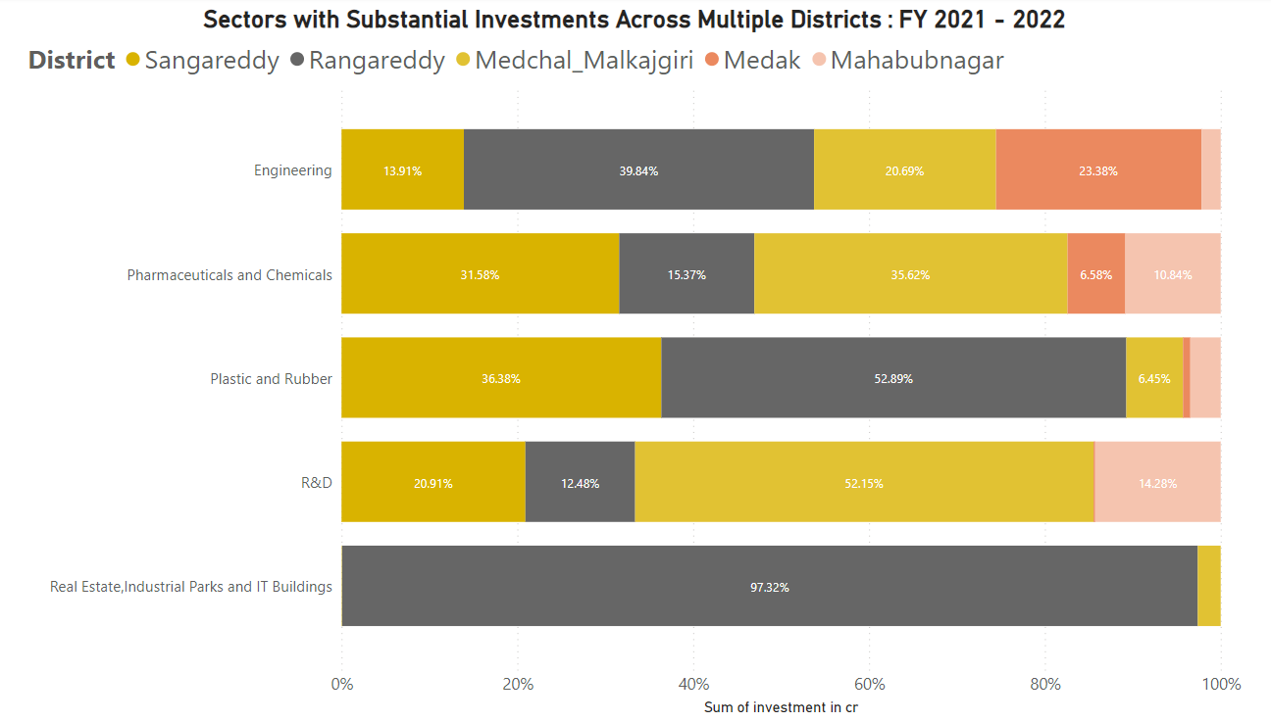
11. Are there any particular sectors that have shown substantial investment in multiple districts between FY 2021 and 2022?

Slide 33


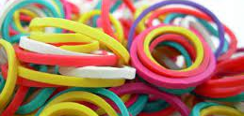

Engineering
Pharmaceuticals and Chemicals
Plastic and Rubber
Investments in the Engineering sector have been substantial in Rangareddy, Medchal Malkajgiri, Medak, and Mahabubnagar districts, reflecting a strong focus on infrastructure and technological advancements.
It has received a lot of investment in the districts of Rangareddy, Sangareddy, Medchal Malkajgiri, Medak, and Mahabubnagar. This shows that this sector is very important and has the potential to grow a lot in the future.
The plastic and rubber sector has attracted significant investments in several districts of Telangana, including Rangareddy, Sangareddy and Medchal Malkajgiri
Real Estate, industrial Parks and IT Building
R & D
Districts that have seen significant R&D investments include Hyderabad, Rangareddy and Sangareddy. The R&D investments led to the development of new products and technologies, and have also helped to create jobs and boost the state's economy.
Notably, this sector has primarily attracted investments in
Rangareddy district, indicating a concentration of real
estate and IT development in that area.

Slide 34
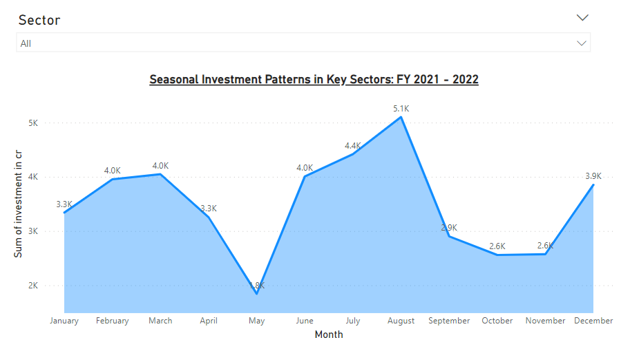

12. Can we identify any seasonal patterns or cyclicality in the investment trends for specific sectors? Do certain sectors experience higher investments during particular months?
Overall Sector Investments
May records the lowest overall sector
investments at 1,842.50 Crores, while
August stands out with the highest
investments at 5,102.22 Crores. This
suggests a potential seasonal trend of
higher investments during the summer
months.

Slide 35



Real Estate, industrial Parks and IT Buildings
Automobile Sector
Engineering Sector
The engineering sector received investments totaling 827.13 Crores in February, which is significantly higher than usual. This suggests that the government and private sector may be focusing on infrastructure and development during this time.
This sector experiences substantial investments in March, amounting to 1,862.96 Crores, indicating a potential pattern related to fiscal year-end planning.
The automobile sector typically experiences lower investment in some months, but there is a surge in investment in October, reaching 219.89 Crores. This is likely due to the launch of new vehicle models and promotions during the festive season.
There are a few reasons why businesses may invest in this sector at the end of the fiscal year. First, they may want to take advantage of tax breaks or deductions that are only available at that time of year. Second, they may be investing in new projects or expanding existing ones, and they need to have the necessary infrastructure in place. Third, they may be meeting contractual obligations or financial targets.
The festive season in India is a time when many people make large purchases, including vehicles. This is why automobile companies often launch new models and offer promotions during this time of year.
The high level of investment in February suggests that the government and private sector are optimistic about the Indian economy and are investing in long-term growth.

Slide 36

Agro-Based and Cold Storage
Cement and Concrete
Agro-Based and Cold Storage The Agro-Based sector, specifically Cold Storage, experiences its highest investments in June at 574.77 Crores, which aligns with the agricultural harvest season.
Investments in the cement and concrete, and fly ash bricks sectors peak in August, at 966.82 Crores. This suggests that there may be a seasonal trend in construction activity, with more construction projects taking place in August than in other months of the year.
The high level of investment in cold storage in June is likely due to the need to store the harvested crops. Cold storage facilities help to extend the shelf life of fruits, vegetables, and other agricultural products, which can help to reduce food waste and improve farmer incomes.

Slide 37

Secondary Research

Slide 38
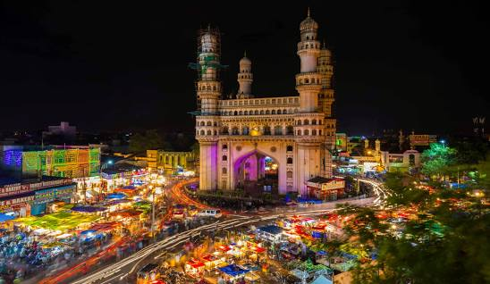
1. The top 5 districts to buy commercial properties in Telangana
1.Hyderabad
Hyderabad is the capital of Telangana and the most populous city in the state. It is a major center for the IT, pharmaceutical, and financial services industries. The city is also home to a number of educational institutions and research centers.

Slide 39
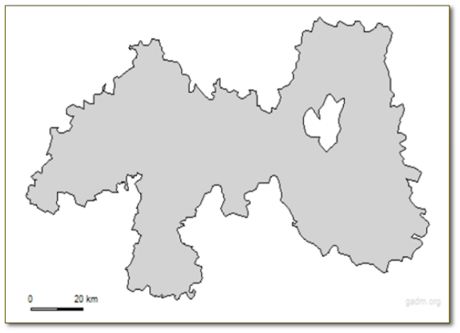
The top 5 districts to buy commercial properties in Telangana
2. Rangareddy
Rangareddy district is located adjacent to Hyderabad and is home to a number of IT and manufacturing companies. The district is also home to the Rajiv Gandhi International Airport.

Slide 40
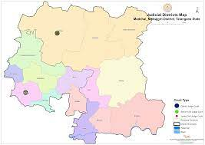
The top 5 districts to buy commercial properties in Telangana
3. Medchal-Malkajgiri
Medchal-Malkajgiri district is located adjacent to Hyderabad and is home to a number of IT and manufacturing companies. The district is also home to the Hyderabad Pharma City.

Slide 41
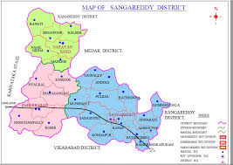
The top 5 districts to buy commercial properties in Telangana
4. Sangareddy
Sangareddy district is located about 50 km from Hyderabad and is home to a number of IT and manufacturing companies. The district is also home to the Telangana Food Processing Zone.

Slide 42
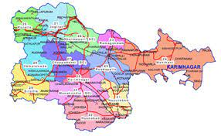
The top 5 districts to buy commercial properties in Telangana
5. Karimnagar
Karimnagar district is located about 170 km from Hyderabad and is a major center for the textile and food processing industries. The district is also home to a number of tourist attractions, such as the Karimnagar Fort and the Laknavaram Lake.
These districts are all well-connected to Hyderabad and have a good infrastructure. They are also home to a number of large and small businesses. As a result, there is a strong demand for commercial properties in these districts.

Slide 43
2. What significant policies or initiatives were put into effect to enhance economic growth, investments, and employment in Telangana by the current government? Can we quantify the impact of these policies using available data?
1
T-Hub (Innovation Ecosystem)
3
4
2
Telangana Startup Policy
Industrial Policy (TS - iPASS)
Telangana Palle Pragathi (Telangana Rural Development)

Slide 44
Industrial Policy (TS - iPASS)
AIM
Impact
TS-iPASS stands for Telangana State Industrial Project Approval and Self Certification System. It is a single-window clearance system for industrial projects in the state of Telangana, India. It was launched in 2014 with the aim of streamlining the process of obtaining approvals for new and existing industries.
TS-iPASS has been successful in attracting new investments to Telangana and in boosting the growth of the state's industrial sector. In 2022-23, TS-iPASS approved over 3,155 industrial projects, with a total investment of over ₹26,358 crores. This is the highest number of projects and investment to be approved in a single year since the launch of TS-iPASS.

Slide 45

T-Hub (Innovation Ecosystem)
AIM
Impact
T-Hub has played a significant role in the growth of the startup ecosystem in Hyderabad. T-Hub has helped over 2,000 startups to scale up and create business value. T-Hub has also helped to attract investments to Hyderabad and to boost the growth of the city's startup economy.
T-Hub is India's largest innovation hub and ecosystem enabler, based out of Hyderabad. It was founded in 2015 with the mission to enable and empower an ecosystem hungry for innovation.

Slide 46

Telangana Startup Policy
AIM
Impact
The Telangana Startup Policy has been successful in attracting startups and investments to the state. In 2022-23, Telangana was ranked as the best performing state for startups in India by the Department for Promotion of Industry and Internal Trade (DPIIT).
The Telangana Startup Policy was launched in 2016 with the aim of fostering an innovation-driven economy in the state. The policy provides a range of incentives and support to startups

Slide 47


Telangana Palle Pragathi (Telangana Rural Development)
AIM
Impact
Telangana Palle Pragathi has been successful in achieving its objectives. Under the scheme, over 26 lakh houses have been constructed, over 1 lakh toilets have been built, and over 10 lakh kilometers of rural roads have been laid. The scheme has also helped to increase agricultural productivity and to create new jobs in rural areas.
Telangana Palle Pragathi is a state-sponsored scheme that aims to transform rural Telangana into a prosperous and vibrant region. The scheme focuses on improving infrastructure, providing basic amenities, and developing the rural economy.

Slide 48
The top 5 Insights & 5 recommendations to Telangana government for sustained growth in the next 5 years based on analysis

Slide 49
Top 5 Insights
1.Strong economic growth
2. Young and skilled workforce
According to the Telangana State Development Planning Society, Telangana recorded a strong economic growth of 16.3% in 2022-23. This is higher than the national average GDP growth rate of 15.4%.
According to the Telangana State Development Planning Society, over 60% of the state's population is below the age of 35. The state also has a high literacy rate, with over 70% of the population being literate.

Slide 50



Top 5 Insights
3. strong industrial base
4. Telangana's favourable business environment
5. Invest In Rural Development
Telangana has a strong industrial base, with major companies such as Amazon, Microsoft, and Google having a presence in the state.
The key features of Telangana's favourable business environment include Low taxes, Easy-to-do-business regulations, Good infrastructure and Skilled workforce The government has set up a number of agencies to help businesses and to resolve any issues they may face.
The Telangana government has taken a number of steps to invest in rural development. The government has launched a number of schemes and programs to improve agriculture, infrastructure, education, healthcare, and skills development in rural areas. However, more needs to be done to accelerate rural development in the state.

Slide 51
5. Developing incentives for environmentally responsible practices can help to encourage businesses and individuals to adopt sustainable practices. The government can provide tax breaks, subsidies, or other incentives to businesses that invest in renewable energy, reduce pollution, or adopt sustainable agriculture practices.
1.Telangana should invest in research and development (R&D) to promote innovation and create new products and services. This will help to make the state's economy more competitive and resilient.
Top 5 Recommendations
4. Promoting job creation and entrepreneurship in rural areas is essential for achieving sustained and inclusive economic growth in Telangana. Rural areas in Telangana account for over 70% of the state's population and contribute significantly to the state's economy. However, rural areas in Telangana also face a number of challenges, including poverty, lack of access to basic infrastructure and services, and limited employment opportunities..
2. Improving skilling and workforce development in Telangana will have a number of benefits for the state. It will help to boost economic growth, create new jobs, and reduce poverty and inequality. It will also help to make Telangana's workforce more competitive and productive.
3. Telangana should keep investing in high-paying sectors like IT, pharmaceuticals, and manufacturing. These sectors offer good jobs and can help the economy grow in other districts as well.

Slide 52
Conclusion
In summary, the Telangana growth analysis project highlights important areas for further investigation and action. These suggest the need for a comprehensive examination of E-stamp registration adoption, an exploration of the causes behind seasonal activity peaks, and a focus on addressing the dominance of motorcycles in the transportation sector. These findings can inform policy decisions and strategies aimed at promoting balanced growth and development in Telangana.

Slide 53
References:
1. Codebasics : Resume Project 7 challenge
https://codebasics.io/challenge/codebasics-resume-project-challenge
2. Open Data Telangana
https://data.telangana.gov.in/
3. Telangana State Development Planning Society
https://www.tsdps.telangana.gov.in/
4. Telangana Life Sciences
https://lifesciences.telangana.gov.in/why-telangana/infrastructure/

Slide 54
Thank you
Gmail: hemanth5shettigar@gmail.com

